Slide 1
Capstone Voice Revenue Analysis
File created on: 07/12/2024 19:36:53

Slide 2
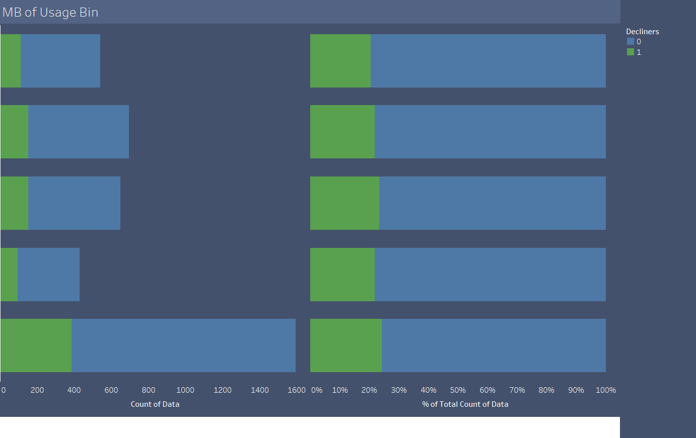

Slide 3
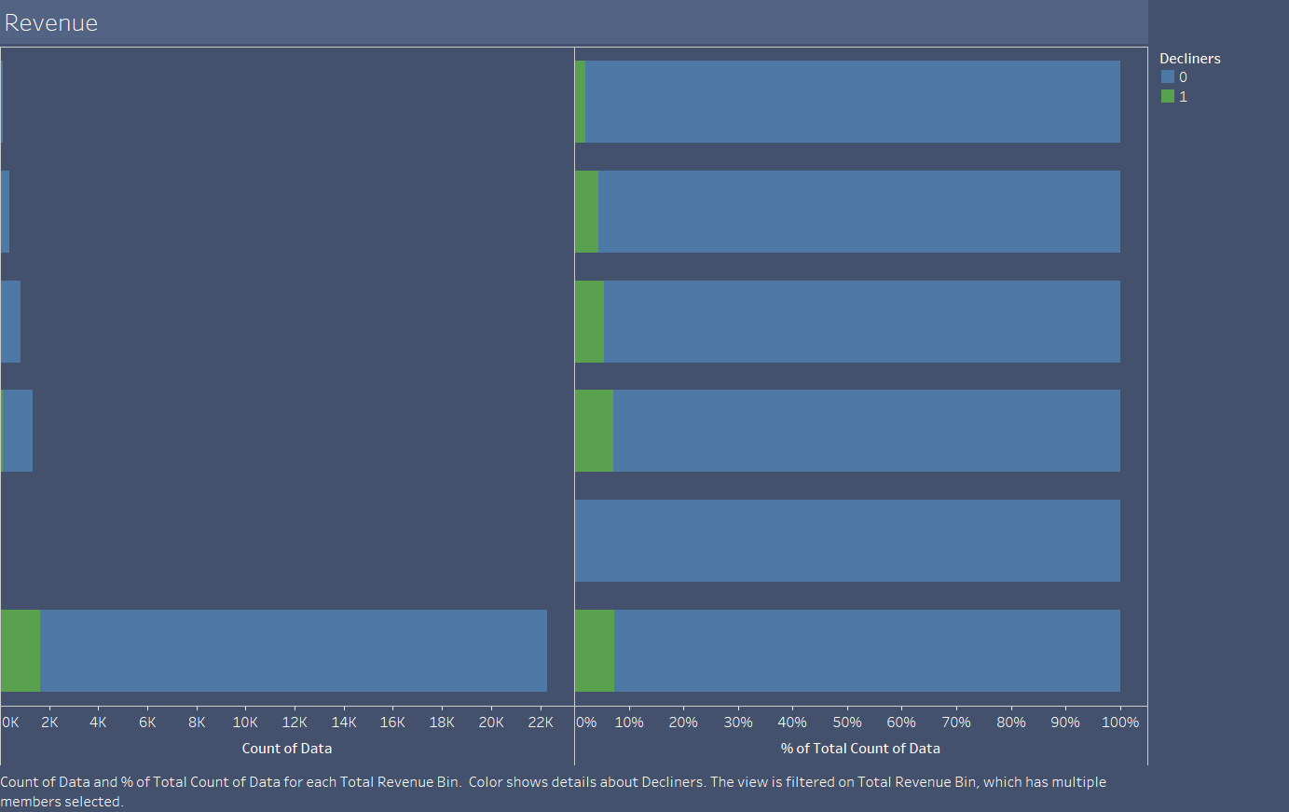

Slide 4
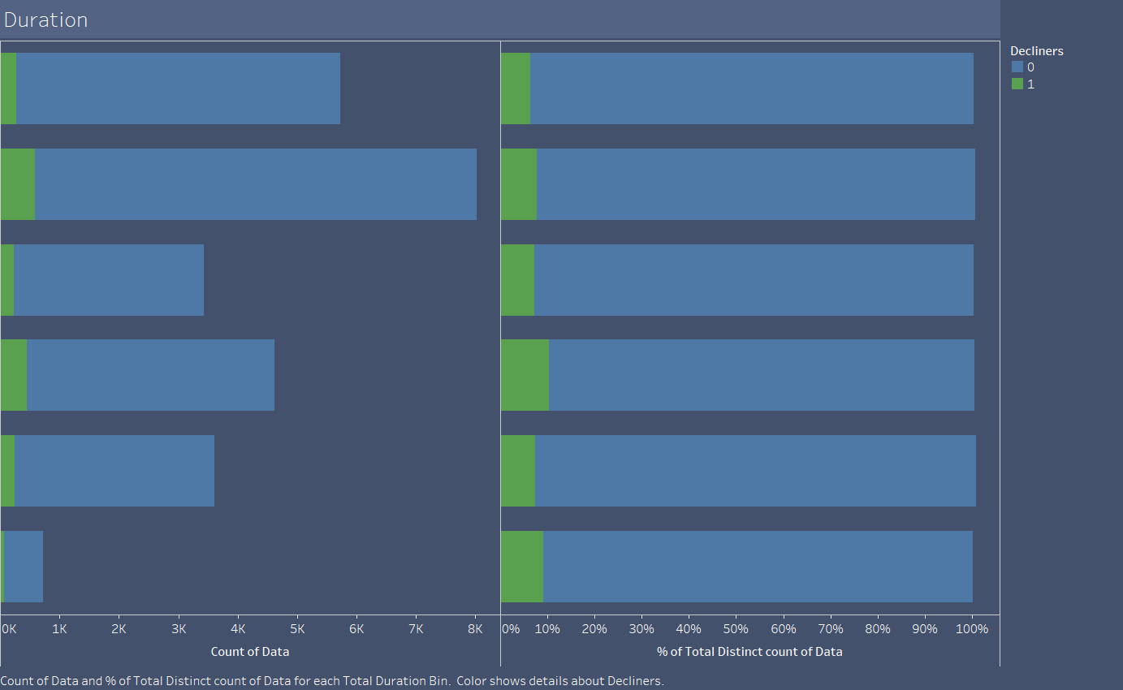

Slide 5


Slide 6
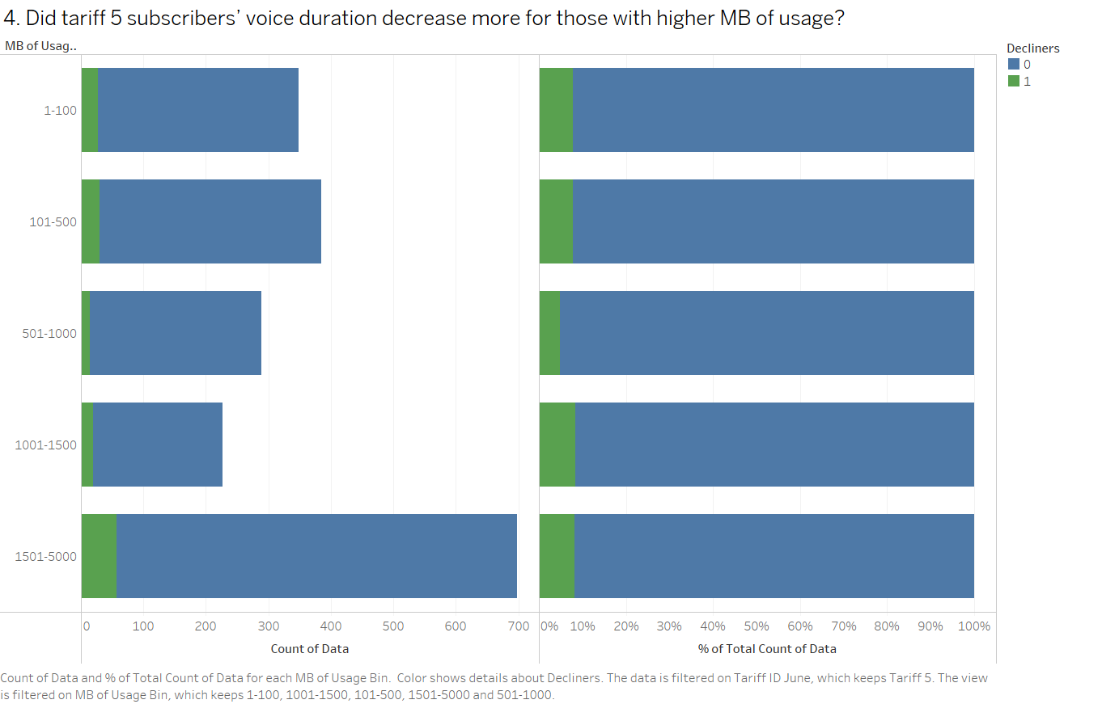

Slide 7
